Slide 1
Spring Security

Slide 2
Agenda
Spring Security
Oauth2
Cross Site Request Forgery (CSRF or XSRF)
Cross-origin Resource Sharing (CORS)
Clickjacking
Other Important Configurations
Spring Profiles

Slide 3
Spring Security

Slide 4

Spring Security
A framework that focuses on providing both authentication and authorization to Java applications.
Like all Spring projects, the real power of Spring Security is found in how easily it can be extended to meet custom requirements.
Notes:
Spring Security is a separate module of the Spring framework that focuses on providing authentication and authorization methods in Java applications.
It also takes care of most of the common security vulnerabilities such as CSRF attacks.

Slide 5
Introduction
This framework targets two major areas of application are authentication and authorization.
Authentication - the process of knowing and identifying the user that wants to access.
There are two processes to make sure that the user is authentic: identification and verification.
For example, a user is authenticated through their username and password
Authorization - the process to allow authority to perform actions in the application.
For example, an ADMIN user has unlimited access to application properties and can change or manipulate them

Slide 6
Advantages
Comprehensive support for authentication and authorization.
Protection against common tasks
Servlet API integration
Integration with Spring MVC
Portability
CSRF protection
Java Configuration support

Slide 7
Features
LDAP (Lightweight Directory Access Protocol)
Single sign-on
JAAS (Java Authentication and Authorization Service) LoginModule
Basic Access Authentication
Digest Access Authentication
Remember-me
Web Form Authentication
Authorization
Software Localization
HTTP Authorization
Notes:
LDAP (Lightweight Directory Access Protocol)
It is an open application protocol for maintaining and accessing distributed directory information services over an Internet Protocol.
Single sign-on
This feature allows a user to access multiple applications with the help of single account(user name and password).
JAAS (Java Authentication and Authorization Service) LoginModule
It is a Pluggable Authentication Module implemented in Java. Spring Security supports it for its authentication process.
Basic Access Authentication
Spring Security supports Basic Access Authentication that is used to provide user name and password while making request over the network.
Digest Access Authentication
This feature allows us to make authentication process more secure than Basic Access Authentication. It asks to the browser to confirm the identity of the user before sending sensitive data over the network.
Remember-me
Spring Security supports this feature with the help of HTTP Cookies. It remember to the user and avoid login again from the same machine until the user logout.
Web Form Authentication
In this process, web form collect and authenticate user credentials from the web browser. Spring Security supports it while we want to implement web form authentication.
Authorization
Spring Security provides the this feature to authorize the user before accessing resources. It allows developers to define access policies against the resources.
Software Localization
This feature allows us to make application user interface in any language.
HTTP Authorization
Spring provides this feature for HTTP authorization of web request URLs using Apache Ant paths or regular expressions.

Slide 8
Configure Spring Security - dependency
To secure our Spring Boot application, we can add the spring-boot-starter-security dependency to pom.xml:
</dependencies>
// ...
<dependency>
<groupId>org.springframework.boot</groupId>
<artifactId>spring-boot-starter-security</artifactId>
</dependency>
</dependencies>

Slide 9
Configure Spring Security – WebSecurityConfigurerAdapter 1
The @EnableWebSecurity annotation and WebSecurityConfigurerAdapter work together to provide web based security
Require the user to be authenticated prior to accessing any URL
Create a user with the username “user”, password “password”, and role of “ROLE_USER”
Enables HTTP Basic and Form based authentication

Slide 10
Configure Spring Security – WebSecurityConfigurerAdapter 2
Example
@EnableWebSecurity
public class HelloWebSecurityConfiguration extends WebSecurityConfigurerAdapter {
@Autowired
public void configureGlobal(AuthenticationManagerBuilder auth) {
auth
.inMemoryAuthentication()
.withUser("user").password("password").roles("USER").and()
.withUser(“admin").password("password").roles(“ADMIN");
}
}
We may use other authentication methods, e.g. LDAP, JDBC, etc.
Add user data

Slide 11
Configure Spring Security – HttpSecurity 1
To enable HTTP Security in Spring, we need to extend the WebSecurityConfigurerAdapter to provide a default configuration in the configure(HttpSecurity http) method:
protected void configure(HttpSecurity http) throws Exception {
http.authorizeRequests()
.anyRequest().authenticated()
.and().formLogin()
.loginPage("/login").permitAll();
}
All requests need to authenticate
Define the login page

Slide 12
Configure Spring Security – HttpSecurity 2
Example - configure some simple authorization on each URL using roles
protected void configure(HttpSecurity http) throws Exception {
http.authorizeRequests()
.antMatchers("/", "/home").access("hasRole('USER')")
.antMatchers("/admin/**").hasRole("ADMIN")
.and()
// some more method calls
.formLogin();
}
When request URL with pattern /admin/**, need ADMIN role to access.

Slide 13
Configure Spring Security – logout
By default, a logout request invalidates the session, clears any authentication caches, clears the SecurityContextHolder and redirects to login page.
However, if you want to get more control over the available handlers, here's what a more complete implementation will look like:
protected void configure(HttpSecurity http) throws Exception {
http.logout().logoutUrl("/my/logout")
.logoutSuccessUrl("/my/index")
.invalidateHttpSession(true)
.deleteCookies(cookieNamesToClear)
.and()
// some other method calls
}
Notes:
SecurityContextHolder - to retrieve the currently authenticated principal

Slide 14
Exercise
Spring Security

Slide 15
Spring – Exercise 1
Key steps (refer Generali-3a-SpringSecurity-exercises.docx Exercise 1 for details)
Generate a Spring Boot project structure using Spring Initializr
Understand the dependencies in pom.xml
Create the controller and define the endpoints
Create the views (JSPs)
Configure Spring Security
Examine the pages
Bonus
Create your own login page
Perform your own logout logic

Slide 16
OAuth2

Slide 17
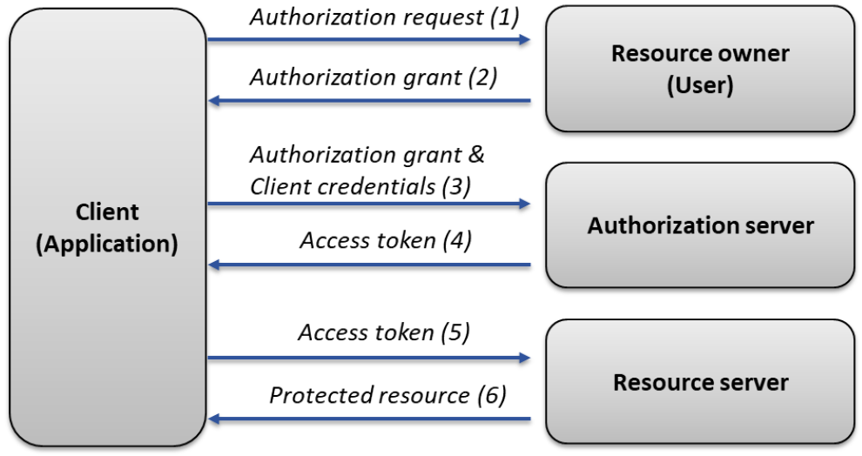
OAuth2
OAuth 2.0 is an open standard, can be used by API providers for authentication and authorization to access resources on behalf of recourse owners without sharing the username / passwords. Many of the largest API publishers have implemented OAuth to handle access to their APIs such as Facebook, Google, Yahoo, etc.
Notes:
OAuth2 defines 4 roles :
Client: application requesting access to a resource server (it can be your PHP website, a Javascript application or a mobile application).
Resource Owner: generally yourself.
Authorization Server: server issuing access token to the client. This token will be used for the client to request the resource server. This server can be the same as the authorization server (same physical server and same application), and it is often the case.
Resource Server: server hosting protected data (for example Google hosting your profile and personal information).

Slide 18
OAuth2 Flow
Authorisation Code Grant
The client prepares a link to the authorization server and opens the link for user in an user agent (browser)
User enters their credentials on the new page
Credentials are sent to authorization server via the user agent (browser)
The authorization server validates the credentials and redirects user back to the client with an authorization code
The client talks with the authorization server, confirms its identify and exchanges the authorization code for an access token and optionally a refresh token
The client uses the access token to access resources on the resource server
Note: the authorization code grant should be very familiar if you’ve ever signed into an application using your Facebook or Google account.
Notes:
The goal of different flows is always the same: to obtain an access_token and use it to access protected resources.

Slide 19
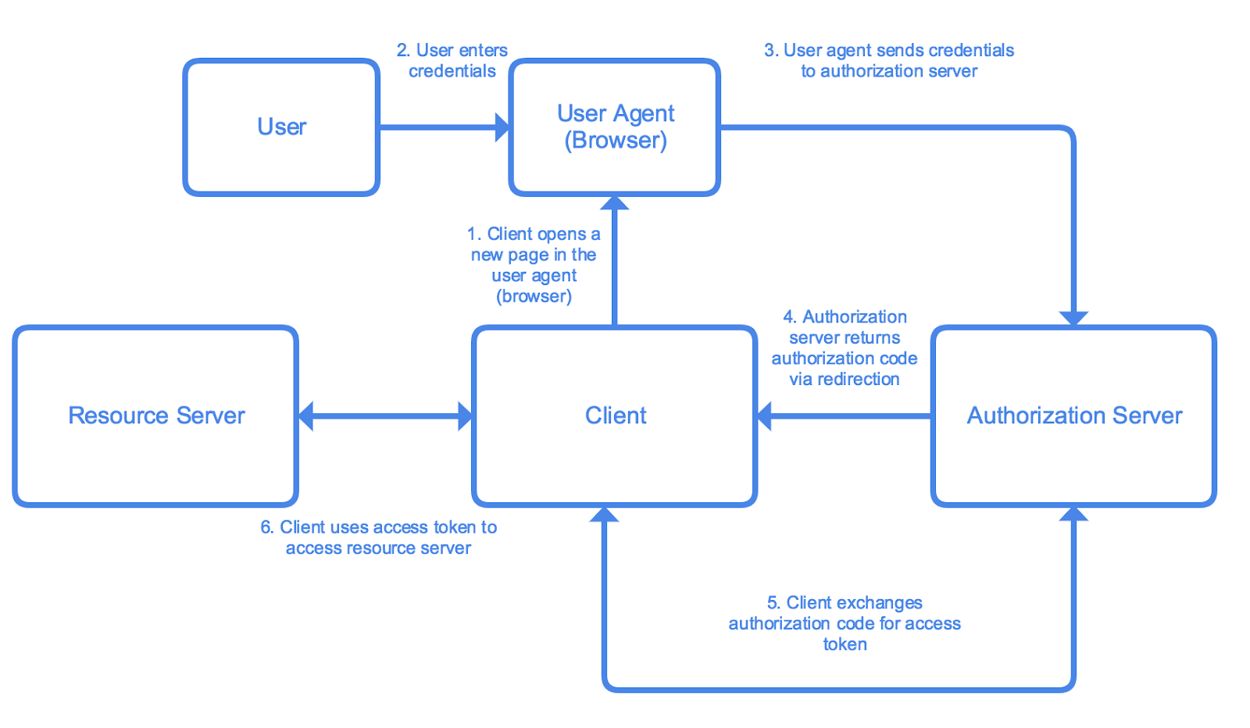
OAuth2 Flow
Authorisation Code Grant
https://medium.com/google-cloud/understanding-oauth2-and-building-a-basic-authorization-server-of-your-own-a-beginners-guide-cf7451a16f66
Notes:
The goal of different flows is always the same: to obtain an access_token and use it to access protected resources.

Slide 20
OAuth2 Flow
Implicit grant
The client will redirect the user to the authorization server
The user will then be asked to login to the authorization server
The authorization server will respond with the access_token
Note:
a. after the user logs in, the access_token is issued immediately.
b. this flow is similar to the Authorization Code flow, except for the part involving authorization code.

Slide 21
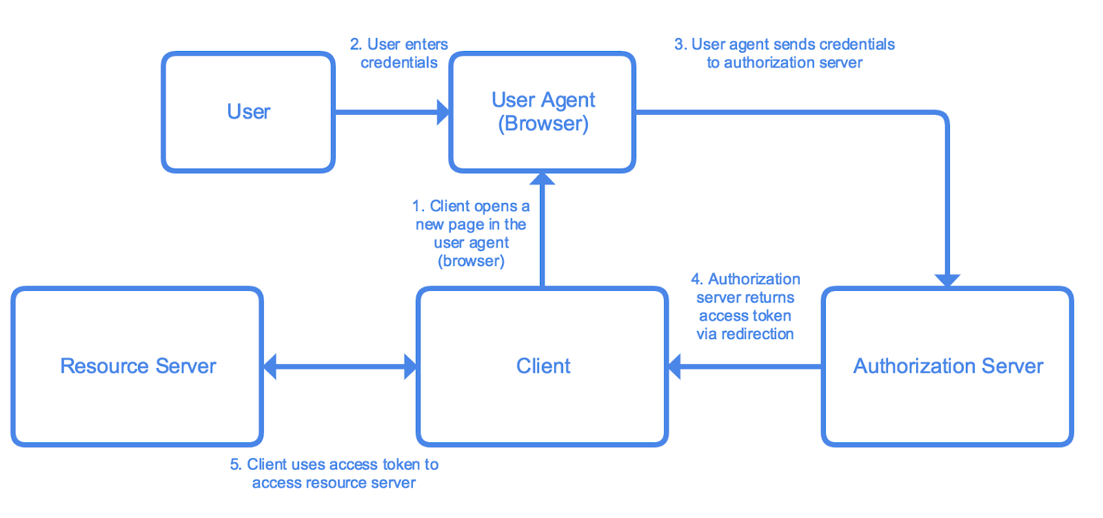
OAuth2 Flow
Implicit grant
https://medium.com/google-cloud/understanding-oauth2-and-building-a-basic-authorization-server-of-your-own-a-beginners-guide-cf7451a16f66
Notes:
The goal of different flows is always the same: to obtain an access_token and use it to access protected resources.

Slide 22
OAuth2 Flow
Client Credential Grant
The client sends a POST request with following body parameters to the authorization server
The authorization server will respond with the access_token
Note: this grant is suitable for machine-to-machine authentication where a specific user’s permission to access data is not required

Slide 23
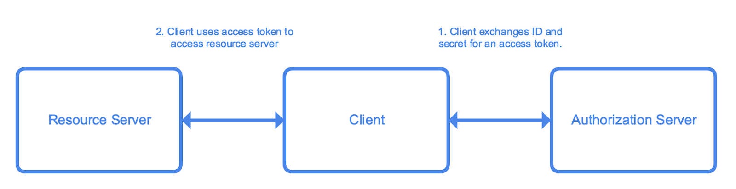
OAuth2 Flow
Client Credential Grant
https://medium.com/google-cloud/understanding-oauth2-and-building-a-basic-authorization-server-of-your-own-a-beginners-guide-cf7451a16f66
Notes:
The goal of different flows is always the same: to obtain an access_token and use it to access protected resources.

Slide 24
OAuth2 Flow
Password Grant
The client prompts user to enter their credentials (for instance, a username/password combination)
The client sends the credentials and its own identification to the authorization server. The authorization server validates the information, then returns an access token and optionally a refresh token
The client uses the access token to access resources on the resource server.
Note: the access_token is issued immediately with a single request containing all login information: username, user password, client id, and client secret.

Slide 25
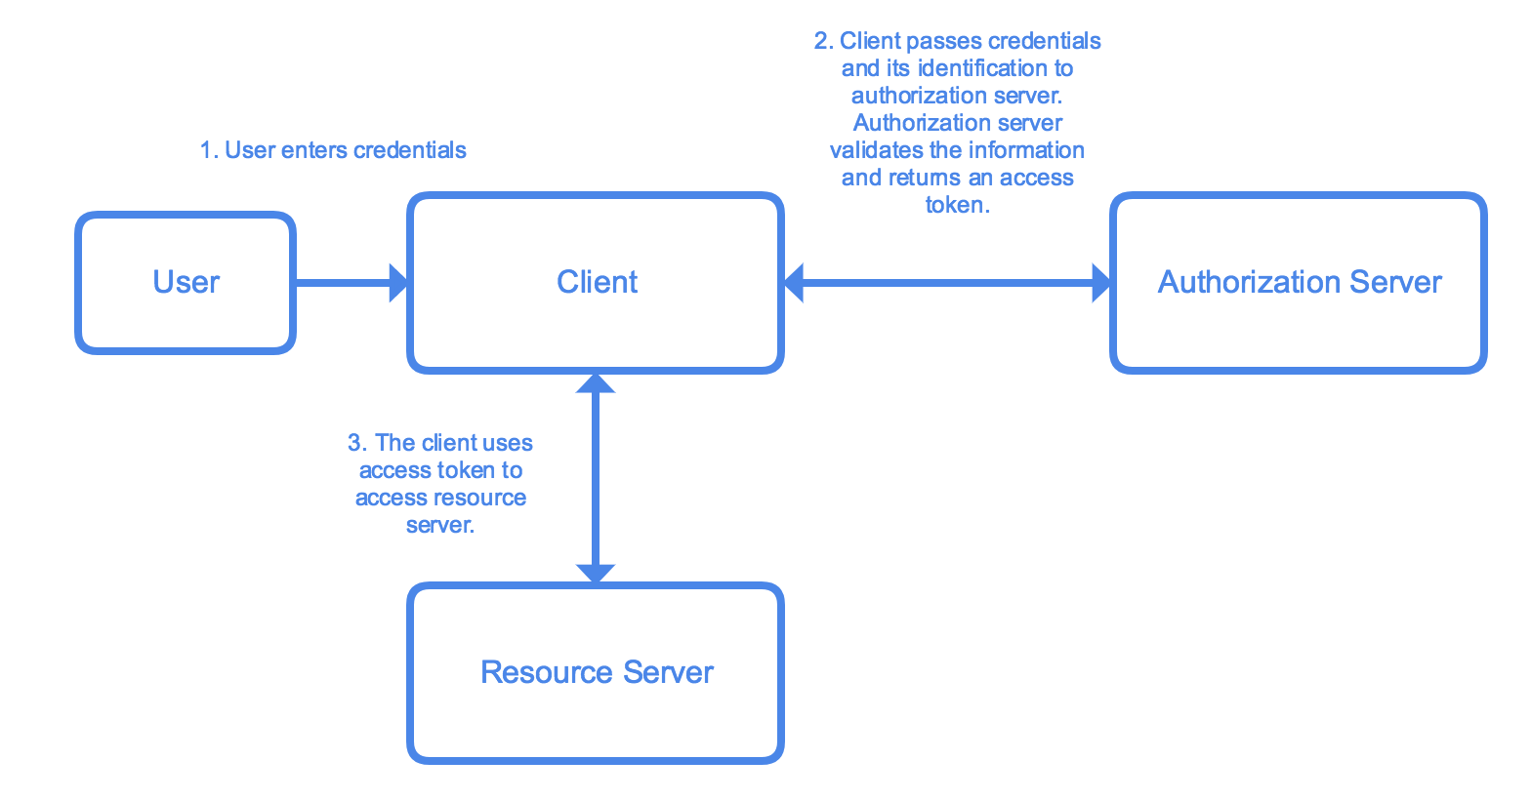
OAuth2 Flow
Password Grant
https://medium.com/google-cloud/understanding-oauth2-and-building-a-basic-authorization-server-of-your-own-a-beginners-guide-cf7451a16f66
Notes:
The goal of different flows is always the same: to obtain an access_token and use it to access protected resources.

Slide 26
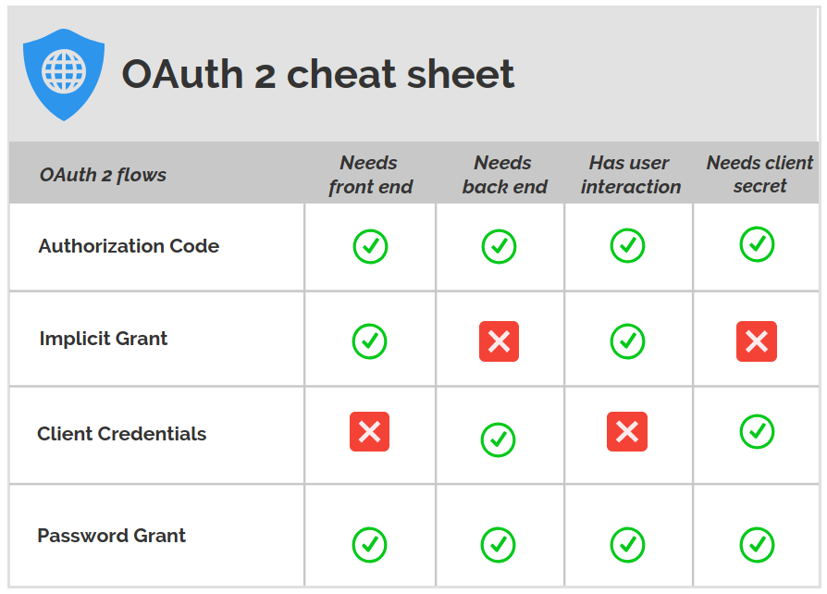
OAuth2 - Differences between Flows
https://medium.com/google-cloud/understanding-oauth2-and-building-a-basic-authorization-server-of-your-own-a-beginners-guide-cf7451a16f66

Slide 27
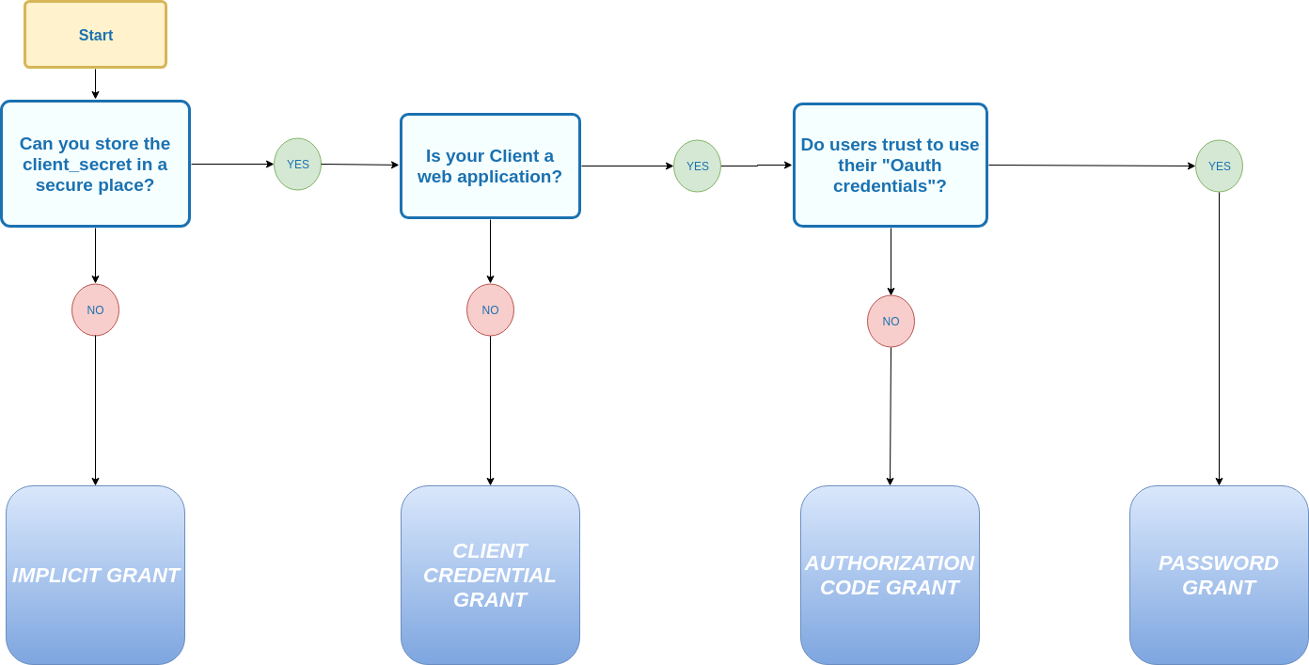
OAuth2 – Which Flow should I choose?
https://medium.com/google-cloud/understanding-oauth2-and-building-a-basic-authorization-server-of-your-own-a-beginners-guide-cf7451a16f66

Slide 28
Cross Site Request Forgery
(CSRF or XSRF)

Slide 29
CSRF Introduction
Scenario
a CSRF attack works when a user has been authenticated against a website
the user receives say a malicious link
the user clicks the link
the attacker performs a state changing operation without the user's knowledge

Slide 30
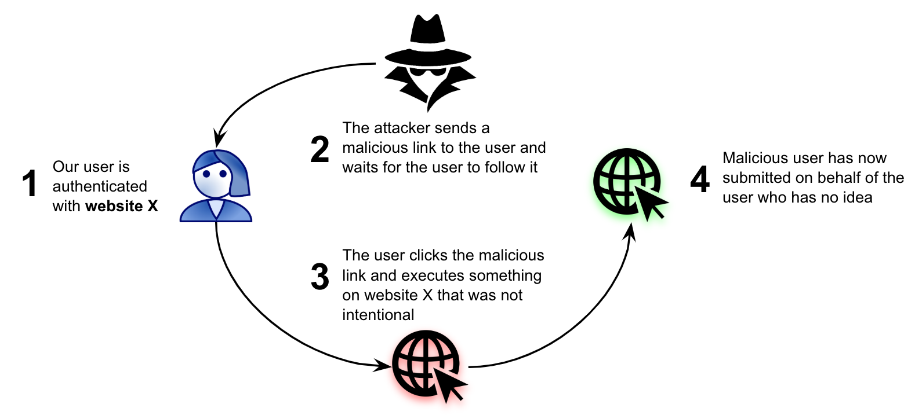
CSRF illustration
https://eleni.blog/2019/09/15/csrf-tokens-and-symfony/

Slide 31
CSRF Attack Example
GET - 1
Let's consider the following GET request used by a logged in users to transfer money to specific bank account “1234”:
GET http://bank.com/transfer?accountNo=1234&amount=100
If the attacker wants to transfer money from a victims' account to his own account instead – “5678” – he needs to make the victim trigger the request:
GET http://bank.com/transfer?accountNo=5678&amount=1000

Slide 32
CSRF Attack Example
GET - 2
There are multiple ways to make that happen:
Link: The attacker can convince the victim to click on this link for example, to execute the transfer:
<a href="http://bank.com/transfer?accountNo=5678&amount=1000">
Show Kittens Pictures
</a>
Image: The attacker may use an <img/> tag with the target URL as the image source – so the click isn't even necessary. The request will be automatically executed when the page loads:
<img src="http://bank.com/transfer?accountNo=5678&amount=1000"/>

Slide 33
CSRF Attack Example
POST - 1
If the main request needs to be a POST request – for example:
POST http://bank.com/transfer
accountNo=1234&amount=100
Then the attacker needs to have the victim run a similar:
POST http://bank.com/transfer
accountNo=5678&amount=1000

Slide 34
CSRF attack example
POST - 2
Neither the <a> or the <img/> will work in this case. The attacker will need a <form> – as follows:
<form action="http://bank.com/transfer" method="POST">
<input type="hidden" name="accountNo" value="5678"/>
<input type="hidden" name="amount" value="1000"/>
<input type="submit" value="Show Kittens Pictures"/>
</form>
However, the form can be submitted automatically using Javascript – as follows:
<body onload="document.forms[0].submit()">
<form>
...

Slide 35
CSRF Prevention
introducing a token that is generated by the website and linked with the user and the form that they are trying to submit.
If the token is not there or if it has expired the user is asked to retry or refresh their web page and try again.
Example:
GET – add a token parameter http://bank.com/transfer?accountNo=1234&amount=100;token=31415926535897932384626433832795028841971
POST – add a field in the form
<input type="hidden" name="${_csrf.parameterName}" value="${_csrf.token}"/>

Slide 36
CSRF Protection in Spring Security
CSRF protection is enabled by default in the Java configuration.
We can still disable it if we need to:
@Override
protected void configure(HttpSecurity http) throws Exception {
http
.csrf().disable();
}

Slide 37
Cross-origin Resource Sharing (CORS)

Slide 38
CORS
CORS is a mechanism that uses additional HTTP headers to tell browsers to give a web application running at one origin, access to selected resources from a different origin. A web application executes a cross-origin HTTP request when it requests a resource that has a different origin from its own.
Web content's origin is defined by the scheme (protocol), host (domain), and port of the URL used to access it. Two objects have the same origin only when the scheme, host, and port all match.
Some operations are restricted to same-origin content, and this restriction can be lifted using CORS.
Notes:
Two URLs have the same origin if the protocol, host, and port are the same for both.

Slide 39
Examples of Same Origin
http://example.com/app1/index.html http://example.com/app2/index.html | same origin because same scheme (http) and host (example.com)
http://Example.com:80 http://example.com | same origin because a server delivers HTTP content through port 80 by default

Slide 40
Examples of Different Origin
http://example.com/app1 https://example.com/app2 | different schemes
http://example.com http://www.example.com http://myapp.example.com | different hosts
http://example.com http://example.com:8080 | different ports

Slide 41
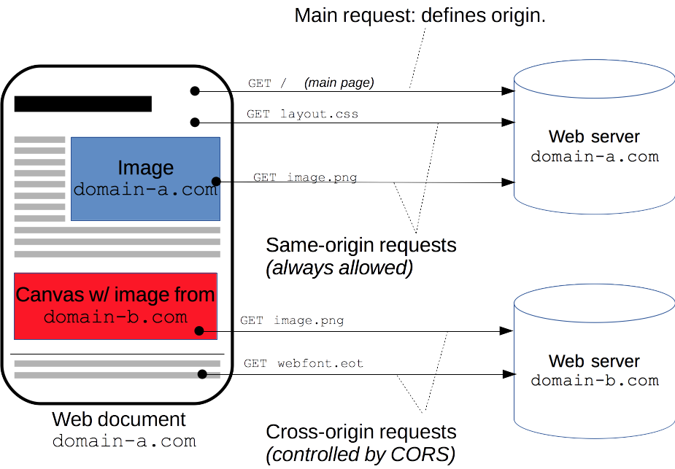
CORS illustration

Slide 42
CORS Configuration in Spring MVC
@CrossOrigin - Class Level
Spring MVC provides @CrossOrigin annotation. This annotation marks the annotated method or type as permitting cross origin requests.
@CrossOrigin at Class / Controller Level
@CrossOrigin(origins = "*", allowedHeaders = "*")
@Controller
public class HomeController {
@GetMapping(path="/")
public String homeInit(Model model) {
return "home";
}
}
* means that all origins are allowed.
If undefined, all origins are allowed.

Slide 43
CORS Configuration in Spring MVC
@CrossOrigin - Method Level
@CrossOrigin at Method Level
@Controller
public class HomeController {
@CrossOrigin(origins = "http://example.com")
@GetMapping(path="/")
public String homeInit(Model model) {
return "home";
}
}
Note: if @CrossOrigin defines in both Class and Method Level, it will be overridden at Method Level

Slide 44
CORS Configuration in Spring Security
@EnableWebSecurity
public class WebSecurityConfig extends WebSecurityConfigurerAdapter {
@Override
protected void configure(HttpSecurity http) throws Exception {
http.cors(); // by default uses a Bean by the name of corsConfigurationSource
}
@Bean
CorsConfigurationSource corsConfigurationSource() {
CorsConfiguration configuration = new CorsConfiguration();
configuration.setAllowedOrigins(Arrays.asList("https://example.com"));
configuration.setAllowedMethods(Arrays.asList("GET","POST"));
UrlBasedCorsConfigurationSource source = new UrlBasedCorsConfigurationSource();
source.registerCorsConfiguration("/**", configuration);
return source;
}
}

Slide 45
CORS vs CSRF
CORS is a method to relax the same-origin policy and CSRF is a vulnerability
CORS is something you might want to use (in certain circumstances) whereas CSRF is an undesirable design mistake.
CORS is also associated with the protection methods of how to prevent CSRF attacks. The most typical way to mitigate the attack is to use anti-CSRF tokens but it is also possible to prevent the attack by checking the Origin: or Referer: header which is related to CORS
Note: it is not a good idea to assume that good CORS rules will prevent all CSRF attacks

Slide 46
Clickjacking

Slide 47
Clickjacking attack example
The attacker creates an attractive page which promises to give the user a free trip to Tahiti.
In the background the attacker checks if the user is logged into his banking site and if so, loads the screen that enables transfer of funds, using query parameters to insert the attacker’s bank details into the form.
The bank transfer page is displayed in an invisible iframe above the free gift page, with the “Confirm Transfer” button exactly aligned over the “Receive Gift” button visible to the user.
The user visits the page and clicks the “Book My Free Trip” button.
In reality the user is clicking on the invisible iframe, and has clicked the “Confirm Transfer” button. Funds are transferred to the attacker.
The user is redirected to a page with information about the free gift (not knowing what happened in the background).

Slide 48
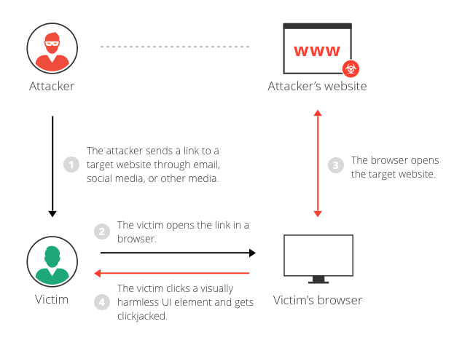
Clickjacking Illustration
https://www.imperva.com/learn/application-security/clickjacking/

Slide 49
Clickjacking vs CSRF
the user is required to perform an action such as a button click whereas a CSRF attack depends upon forging an entire request without the user's knowledge or input
Protection against CSRF attacks is often provided by the use of a CSRF token
Clickjacking attacks are not mitigated by the CSRF token as a target session is established with content loaded from an authentic website and with all requests happening on-domain.
Clickjacking uses a normal user session that occurs within a hidden iframe.

Slide 50
Clickjacking Protection in Spring Security
X-Frame-Options
The X-Frame-Options response header instructs the browser to prevent any site with this header in the response from being rendered within a frame. By default, Spring Security disables rendering within an iframe (i.e. X-Frame-Options: DENY).
You can customize X-Frame-Options. For example, the following use "X-Frame-Options: SAMEORIGIN" which allows iframes within the same domain:
@EnableWebSecurity
public class WebSecurityConfig extends WebSecurityConfigurerAdapter {
@Override
protected void configure(HttpSecurity http) throws Exception {
http.headers().frameOptions().sameOrigin();
}
}
Notes:
frame-options
DENY The page cannot be displayed in a frame, regardless of the site attempting to do so. This is the default when frame-options-policy is specified.
SAMEORIGIN The page can only be displayed in a frame on the same origin as the page itself
ALLOW-FROM origin The page can only be displayed in a frame on the specified origin.
In other words, if you specify DENY, not only will attempts to load the page in a frame fail when loaded from other sites, attempts to do so will fail when loaded from the same site. On the other hand, if you specify SAMEORIGIN, you can still use the page in a frame as long as the site including it in a frame it is the same as the one serving the page.

Slide 51
Other Important Configurations

Slide 52
HTTPS Channel Security
Force your URL to use HTTPS
@EnableWebSecurity
public class WebSecurityConfig extends WebSecurityConfigurerAdapter {
@Override
protected void configure(HttpSecurity http) throws Exception {
http.requiresChannel().anyRequest().requiresSecure();
}
}
Or use port mapping:
http.portMapper().http(8080).mapsTo(8443);

Slide 53
Session Timeout
Define the URLs to handle session issues under WebSecurityConfigurerAdapter:
@Override
protected void configure(HttpSecurity http) throws Exception {
http.sessionManagement()
.expiredUrl("/sessionExpired")
.invalidSessionUrl("/sessionInvalid");;
}
Define timeout value in application.properties file:
server.servlet.session.timeout=15m
Note: if we don't specify the duration unit, Spring will assume it's seconds.
Notes:
expiredUrl - if the user sends a request with an expired session id, it will be redirected to this URL
invalidSessionUrl - if the user sends a request with a session id which is not expired, but entirely invalid, they will also be redirected to this URL

Slide 54
Spring Profiles

Slide 55
Spring Profiles
As of Spring 3.1, we can now map our beans to different profiles – for example, dev, test, prod.
Spring Profiles provide a way to segregate parts of your application configuration and make it be available only in certain environments.
Any @Component or @Configuration can be marked with @Profile to limit when it is loaded.

Slide 56
@Profile
This @Profile annotation can be applied at class level or method level.
@Configuration
@Profile("dev")
public class DoctorDev {
@Bean
public Doctor getFakeDoctor() {
// return a fake doctor
}
}
@Configuration
@Profile("prod")
public class DoctorProd {
@Bean
public Doctor getRealDoctor() {
// return a real doctor
}
}

Slide 57
Set the active profile – web.xml
Context Parameter in web.xml
<context-param>
<param-name>contextConfigLocation</param-name>
<param-value>/WEB-INF/app-config.xml</param-value>
</context-param>
<context-param>
<param-name>spring.profiles.active</param-name>
<param-value>dev</param-value>
</context-param>

Slide 58
Set the active profile – other examples
JVM System Parameter
The profile names can also be passed in via a JVM system parameter.
-Dspring.profiles.active=dev
Environment Variable
In a Unix environment, profiles can also be activated via the environment variable:
export spring_profiles_active=dev
@ActiveProfile in Tests
using the @ActiveProfile annotation to enable specific profile in Tests:
@ActiveProfiles("dev")
Notes:
Other ways to activate a specific profile

Slide 59
Set the active profile – Spring Boot
specify active profiles in application.properties
spring.profiles.active=dev
Spring Boot will automatically load the properties in an application.properties file for all profiles, and the ones in profile-specific .properties files only for the specified profile.
In this case, all properties will be loaded from:
application-dev.properties
Notes:
The most important profiles-related feature that Spring Boot brings is profile-specific properties files.

Slide 60
Summary
What is covered
Spring Security
Oauth2
Cross Site Request Forgery (CSRF or XSRF)
Cross-origin Resource Sharing (CORS)
Clickjacking
Other Important Configurations
Spring Profiles

